Slide 1








ENHANCING IMAGE STEGANOGRAPHY USING GANS AND REDUNDANT LSB TECHNIQUES
By :
Chinmay Sanjay Chaudhari(21BCE1250)
Siddhant Rawat(21BCE1253)
Rishu Ravi Singh(21BCE1306)

Slide 2

INTRODUCTION
THE PROJECT FOCUSES ON IMAGE STEGANOGRAPHY USING DEEP LEARNING AND AI TECHNIQUES. IT EXPLORES HOW NEURAL NETWORKS AND IMAGE PROCESSING ALGORITHMS CAN SECURELY EMBED AND EXTRACT SECRET MESSAGES INTO IMAGES WHILE ENSURING DATA INTEGRITY AND VISUAL INDISTINGUISHABILITY.
THE DEVELOPED SYSTEM LEVERAGES GANS (GENERATIVE ADVERSARIAL NETWORKS) AND LSB (LEAST SIGNIFICANT BIT) REDUNDANCY FOR ROBUST STEGANOGRAPHIC OPERATIONS.
The approach blends computer vision, neural network design, and steganography to enhance data security and provide a novel application of GAN-based models in multimedia content protection.

Slide 3
PROBLEM STATEMENT
CONVENTIONAL METHODS OF DATA HIDING OFTEN SUFFER FROM:
LIMITED CAPACITY TO EMBED DATA.
VULNERABILITY TO TAMPERING AND DETECTION BY ATTACKERS.
HIGH COMPUTATIONAL REQUIREMENTS OR POOR QUALITY OF THE STEGO IMAGES.
THESE CHALLENGES NECESSITATE A SECURE, EFFICIENT, AND SCALABLE STEGANOGRAPHY SYSTem capable of embedding and extracting information without compromising visual quality or computational resources.

Slide 4
OBJECTIVES
SYSTEM DESIGN: CREATE A SECURE, SCALABLE PROTOTYPE FOR STEGANOGRAPHY USING GENERATIVE MODELS.
UNDETECTABLE COMMUNICATION: ENSURE SYNTHESIZED IMAGES EMBED MESSAGES WITHOUT CONVENTIONAL METHODS, LEVERAGING NATURAL Image features.
Data Integrity: Embed authentication information for secure message extraction.
High Visual Quality: Maintain a high PSNR (Peak Signal-to-Noise Ratio) to ensure realistic, indistinguishable visuals.

Slide 5
PROPOSED SYSTEM
OUR INNOVATIVE SYSTEM INTEGRATES THE FOLLOWING MODULES FOR COVERT COMMUNICATION:
Generative Network:
UTILIZES A MODIFIED GAN TO GENERATE REALISTIC IMAGES FROM NOISE VECTORS.
THE GENERATED IMAGES INHERENTLY EMBED SECRET MESSAGES, AVOIDING DIRECT
PIXEL MANIPULATION.
LSB-based Redundant Embedding:
Applies a Least Significant Bit (LSB) encoding mechanism with redundancy
for error correction and Ensures data accuracy even in noisy environments.
Image Transformation Module:
Camouflages stego images with natural transformations for enhanced
security.
Authentication Component:
Embeds validation data to ensure only authorized users can decode
messages.

Slide 6

LIST OF MODULES
GAN AND IMAGE PROCESSING
TORCH: Neural network training and inference.
cv2 (OpenCV): Image manipulation (resizing, BLending, saving).
Steganography Operations
NumPy: Numerical computations and pixel-level manipulations.
COLLections.defaultdict: Error correction IN MESsage extraction.
Web Application Framework
Flask: Provides a user-friendly web interface for generating AND extracting steganographic images.
Os: Manages file uploads and storage.

Slide 7
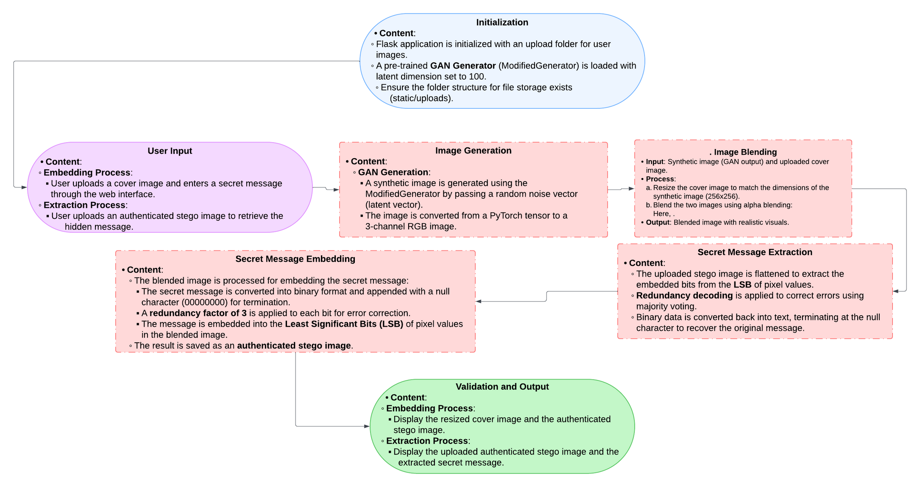
WORKFLOW DIAGRAM FOR IMAGE GENERATION AND STEGNOGRAPHY SYSTEM

Slide 8

DETAILED SYSTEM COMPONENTS
STEP 1: IMAGE GENERATION USING GANS
OVERVIEW:
GANs generate synthetic images frOM RANDOM NOISE.
THE MODIFIED GENERATOR CREATES 256X256 IMAGES, IDEAL FOR STEGANOGRAPHY.
PROCESS:
INITIALIZE A LATENT VECTOR (LATENT_DIM=100), INPUT RANDOM NOISE.
PASS IT THROUGH THE GAN TO GENERATE AN RGB IMAGE.
NORMALIZE THE OUTPUT FOR COMPATIBILITY.

Slide 9

DETAILED SYSTEM COMPONENTS
STEP 2: BLENDING SYNTHETIC AND COVER IMAGES
OVERVIEW:
Alpha blending combines the GAN-generated image with A COVER IMAGE TO
CREATE A SEAMLESS RESULT.
PROCESS:
RESIZE THE COVER IMAGE (256X256) TO MATCH THE SYNTHETIC IMAGE.
APPLY BLENDING FORMULA:
BLENDED IMAGE = Α×SYNTHETIC IMAGE+(1−Α)×COVER IMAGE
WHERE Α=0.15
KEY FEATURES:
PRESERVES THE COVER IMAGE’S LOOK.
CONTROLS THE SYNTHETIC IMAGE'S VISIBILITY WITH THE BLENDING FACTOR.

Slide 10

DETAILED SYSTEM COMPONENTS
STEP 3: SECRET MESSAGE EMBEDDING USING LSB
OVERVIEW:
LSB embeds a secret message intO THE PIXEL DATA OF THE BLENDED IMAGE.
PROCESS:
CONVERT THE MESSAGE TO BINARY AND APPEND A NULL CHARACTER.
REPLACE THE LSB OF PIXELS WITH THE MESSAGE BITS.
USE REDUNDANCY FOR ERROR CORRECTION.
KEY FEATURES:
DATA IS HIDDEN WITHOUT VISUAL DISTORTION.
RESILIENT TO NOISE DURING TRANSMISSION.

Slide 11

DETAILED SYSTEM COMPONENTS
STEP 4: EXTRACTING THE SECRET MESSAGE
OVERVIEW:
EXTRACTs the hidden message frOM THE STEGO IMAGE BY DECODING THE LSBS.
PROCESS:
FLATTEN PIXEL DATA, EXTRACT LSBS, GROUP IN 3-BIT CHUNKS.
PERFORM MAJORITY VOTING TO CORRECT ERRORS AND DECODE THE MESSAGE.
KEY FEATURES:
RELIABLE EXTRACTION, EVEN WITH NOISE.
ENSURES MESSAGE INTEGRITY WITH ERROR CORRECTION.

Slide 12
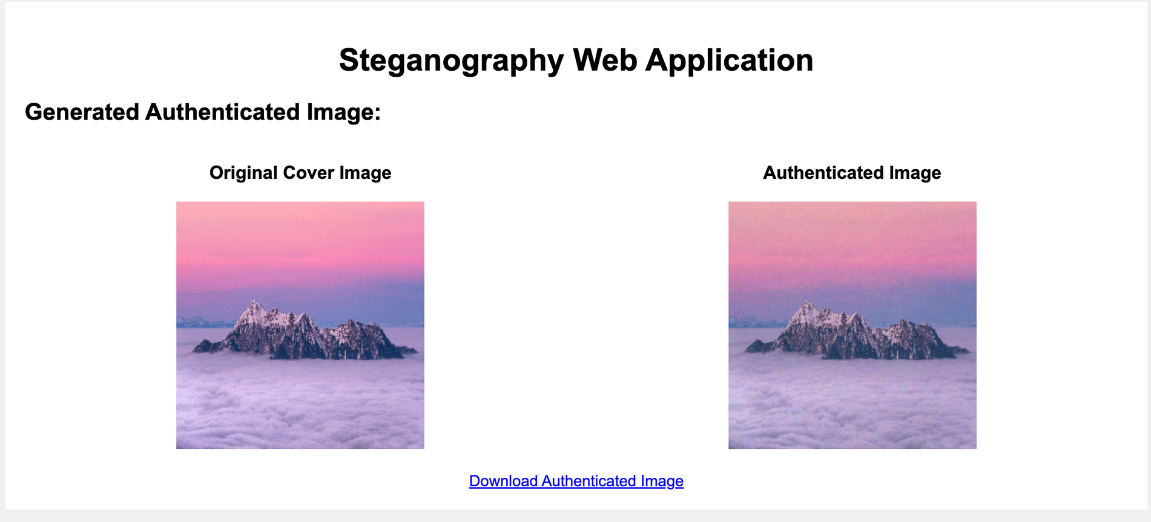
OUTCOME OF THE WORK

Slide 13

CONCLUSION:
GAN-BASED IMAGE GENERATION: GENERATIVE ADVERSARIAL NETWORKS (GANS) ENABLE THE CREATION OF SYNTHETIC IMAGES FROM RANDOM NOISE, WHICH PROVIDES A HIGH LEVEL OF FLEXIBILITY WITHOUT THE NEED FOR AN EXISTING COVER IMAGE.
Alpha Blending: The process of blending the GAN-generated image with a cover image using alpha blending ensures that the final stego image maintains the visual appearance of the original cover while hiding the synthetic content effectively.
Message Embedding via LSB: The Least Significant Bit (LSB) method securely embeds a secret message into the pixel data of the blended image, ensuring minimal visual distortion. The added redundancy helps correct errors, making the system more resilient to noise or tampering.
Web Interface: A user-friendly Flask-based web interface allows users to easily upload images for embedding or extraction, making the system accessible for practical use in secure communications.

Slide 14
FUTURE WORK
ENHANCE GAN MODELS: IMPROVE GAN ARCHITECTURES FOR HIGHER-RESOLUTION IMAGES AND BETTER VISUAL FEATURES, MAKING STEGO CONTENT HARDER TO DETECT.
Explore Alternative Embedding Techniques: Investigate methods like multi-channel embedding or adaptive steganography to increase security and reduce detectability.
Improve Error Correction: Implement more advanced error correction methods (e.g., Hamming codes) to enhance robustness and reliability during message extraction.
Enhance User Interface: Improve the web interface with features like batch processing, real-time feedback, and better visualization of the embedding process.
Increase Steganalysis Resistance: Develop techniques to make stego images harder to detect by steganalysis tools, enhancing security in sensitive applications.

